Slide 1
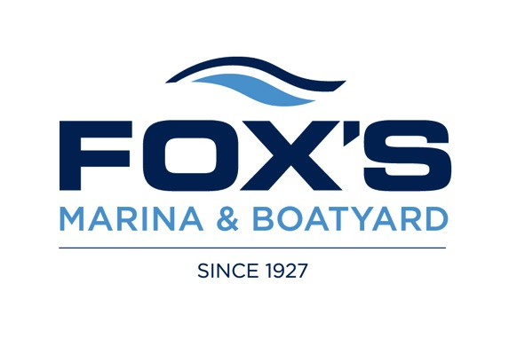

The complete service centre for all yachts and commercial craft

Slide 2
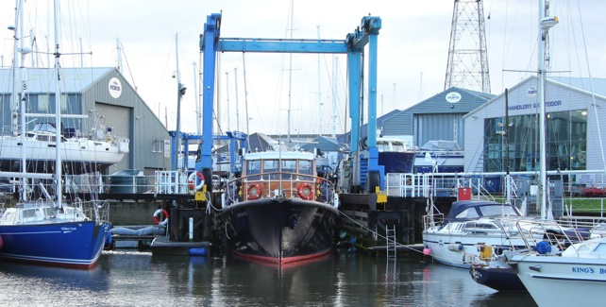

FOX’S MARINA & BOATYARD
Fox’s Marina & Boatyard has some of the best boatyard facilities to be found anywhere in the country, with dedicated departments all located on our own 15 acre site.
Our 50 and 70 tonne travel lifts and expert boat handlers allow us to lift and move boats at very short notice, whilst our extensive purpose built workshops, sprayshop and rigging department mean any of our trades can comfortably work on vessels up to 85 feet LOA, in all weathers.
foxsmarina.com

Slide 3
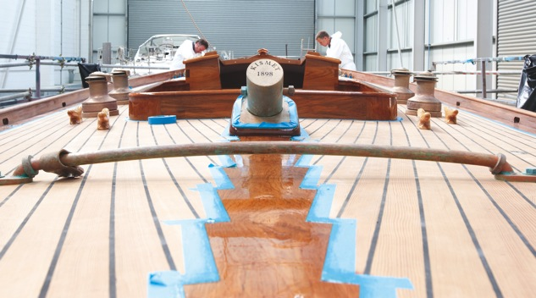
FOX’S MARINA & BOATYARD
At Fox’s Marina & Boatyard our experienced managers and highly skilled engineers and craftsmen have a wealth of knowledge in project managing and working on a huge range of sailing and motor yachts, classics and commercial craft, built in any material.
foxsmarina.com

Slide 4
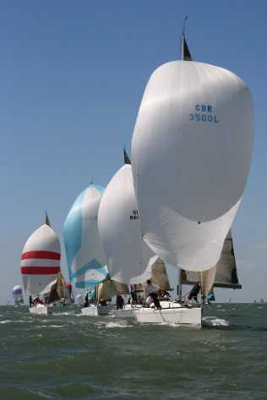
FOX’S MARINA & BOATYARD SERVICES
Marina berthing and hard standing with power, water and fuel
70 and 50 ton travel lifts
Refit and repair specialists
Joinery and teak decking
Spray painting and varnish
GRP and gelcoat repairs
Coppercoat, osmosis and epoxy bottom treatments
Electronics supply and installation
Marine engineering and installation
Running and standing rigging for cruising and racing
Stainless fabrication – marine and commercial
Fox’s Marine and Country Store
foxsmarina.com

Slide 5
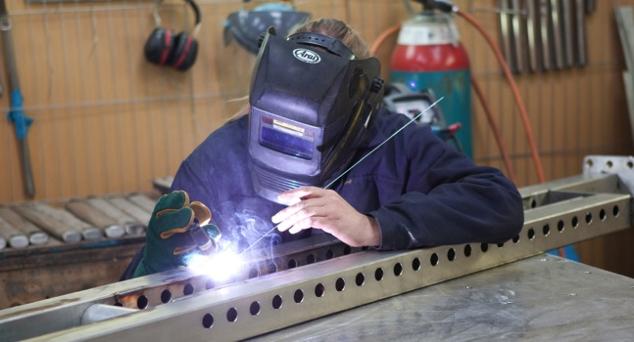
FOX’S STAINLESS FABRICATION
Custom stainless fabrication for all Marine, Domestic, Commercial and Industrial applications
Fabrication of stem head fittings, deck fittings, mast fittings, bow rollers and chain plates for luxury yacht builders, Oyster, Gunfleet and Spirit Yachts
Mobile welding, polishing, tube work and service
Emergency repairs
foxsmarina.com

Slide 6
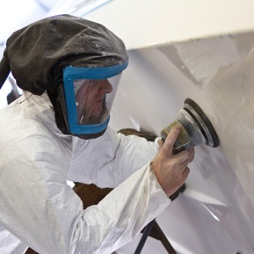
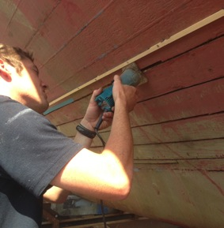
FOX’S WORKSHOPS
Experienced shipwrights for joinery and teak decking
Awlgrip approved paint application centre
Repairs to GRP and Composite hull and decks
Osmosis, Epoxy and Copper bottom treatments
Traditional timber hull repairs and refastening
Custom modifications in timber and GRP
Bowthruster installations
Keel boat checks
foxsmarina.com

Slide 7
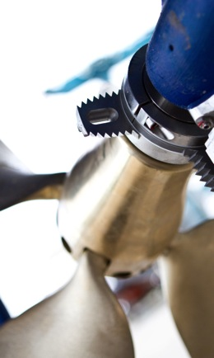
FOX’S ENGINEERING
Engine and Generator servicing and installation
Engine paint touch up to complete re-builds
Seacock and through hull service and replacement
Toilet servicing - Black, Grey and Raw water systems
Installation and overhaul of hydraulic systems
Rudder and Steering gear checks
Stern gear and drive train refurbishment
foxsmarina.com

Slide 8
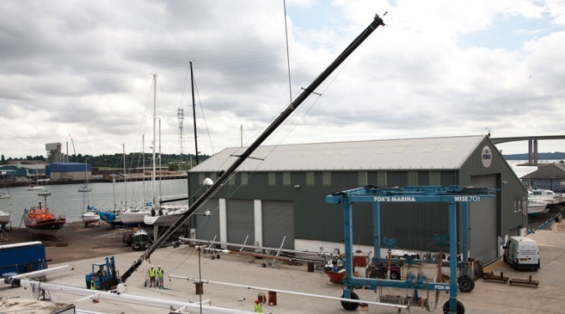
FOX’S RIGGING
As one of only three Seldén approved Technical Centres, Fox’s Rigging is well equipped to carry out all aspects of rig maintenance and re-rigging on almost any type of vessel.
foxsmarina.com

Slide 9
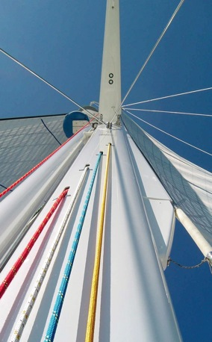
FOX’S RIGGING
Rig maintenance and upgrades
Wire swaging up to 28mm and Rod cold heading to -115
Running rigging in traditional three strand, braid line and latest low stretch spectra.
Splicing, stripped and tapered control lines and halyards
Suppliers of Gottifredi Maffioli world class cordage
Spars and poles in Carbon, Alloy and Timber
Manual, Electric and Hydraulic mainsail and headsail furling systems
Deck gear and the latest downwind sail handling systems
foxsmarina.com

Slide 10
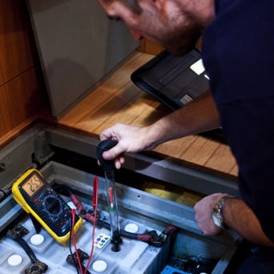
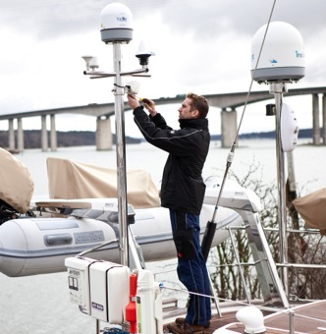
FOX’S ELECTRONICS
Navigation equipment
Fault finding
New installations
Communication and computer systems
Alternative power sources - solar and wind
Low energy LED lighting
foxsmarina.com

Slide 11
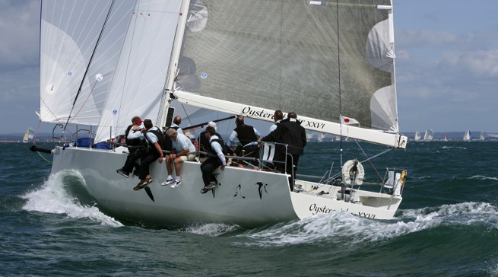
FOX’S RACING SUPPORT
Fox’s can provide the latest in carbon spars, standing and running rigging and deck hardware solutions
Re-fairing and finishing foils and bottoms for that extra low drag finish, Fox’s continues to be key to many successful international racing campaigns
foxsmarina.com

Slide 12
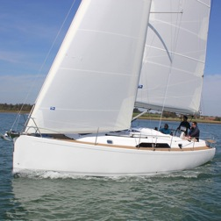
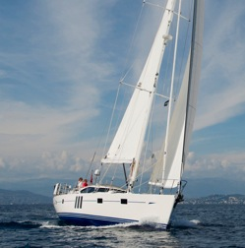
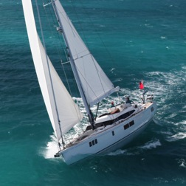
FOX’S NEW YACHT COMMISSIONING
Some of the world’s best known sailing and motor yacht brands, including Gunfleet, GT, Hardy, Oyster and Spirit Yachts all use Fox’s for custom stainless, electronic installation and testing, standing and running rigging, sail trails and general commissioning services.
foxsmarina.com

Slide 13
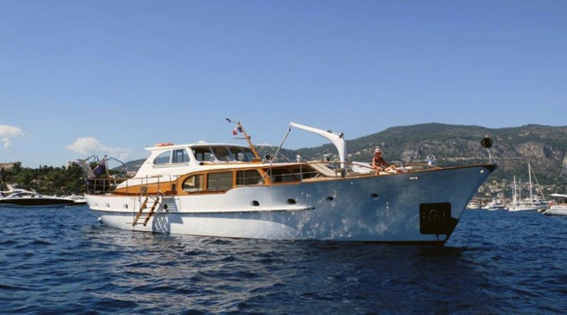
TIKY – 1960 18.8m Feadship
Extensive refit work including installation of new pilothouse, blasting, fairing and spraying bottom and topsides, engineering and refurbishment of all stainless.
foxsmarina.com

Slide 14
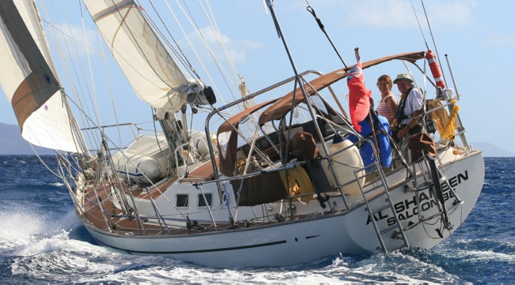
AL SHAHEEN – 2001 Mike Pocock 42’ one off cruising yacht
Substantial refit including new decks, teak caprail and complete re-spray.
foxsmarina.com

Slide 15
“You have a very skilled workforce with excellent customer relations and excellent work attitudes. They all seem highly motivated and dedicated to high quality service.”
John Franklin – Commodore OCC and owner of Pocock 42, Al Shaheen
foxsmarina.com

Slide 16
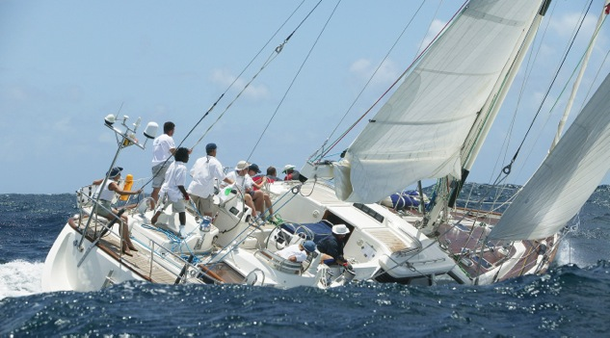
PEARLFISHER – Oyster 62
Comprehensive refit to rig - including carbon mast stripping and composite repairs, repaint and re-stepped with new rods and running rigging
Service of air-conditioning and vacuum WC systems
Rebuild of complete drive train and stern gear
Modifications to joinery and custom flat screen TV stowage
foxsmarina.com

Slide 17
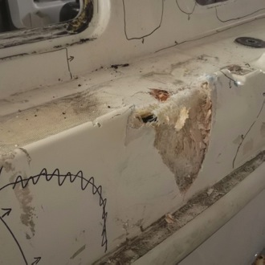
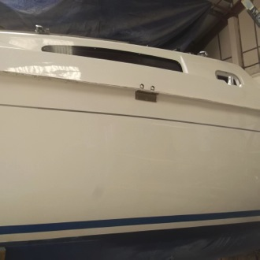
JEANNEAU 24
Collision damage left this yacht as a possible insurance write off.
Fox’s careful and considered approach to the re-building and re-finishing of both
the hull and superstructure mouldings produced an invisible repair and she was afloat and sailing again within weeks.
foxsmarina.com

Slide 18
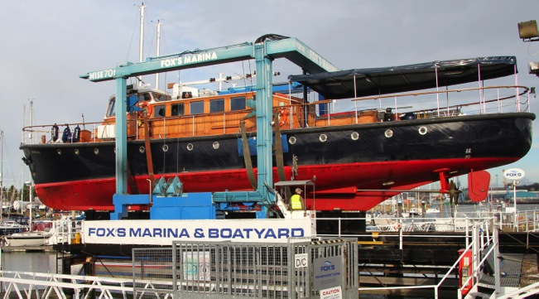
HAVENGORE – 1956 River Thames Cruiser
Annual maintenance and refit including repairs to planking, keel bolt checks, teak deck repairs and topsides repaint.
foxsmarina.com

Slide 19
“Facilities at Fox’s Marina are second to none, they have a highly motivated team who were efficient and easy to work with. The refit was superbly managed, and we are extremely happy with the quality of the work, all of which was delivered on time and to budget.”
Julia Linehan – Operations Director, Havengore
foxsmarina.com

Slide 20
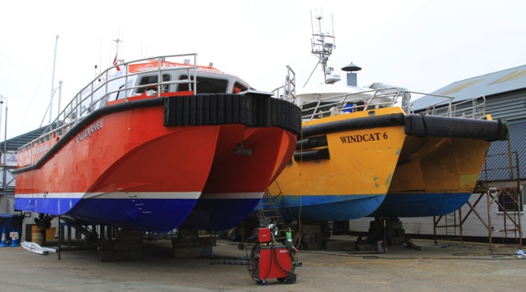
COMMERCIAL WORK
Coded welding modifications to aluminium alloy hull and stainless raw water systems
Undercover respray using airless International two pack
Repair and service of engines, drive train and engineering systems
foxsmarina.com

Slide 21
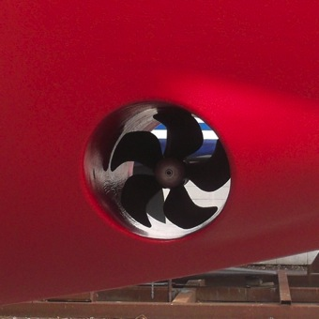
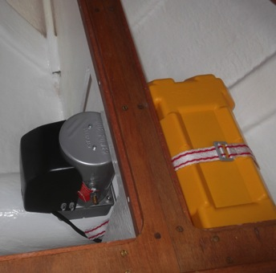
VICTORIA 34 – Typical new bowthruster installation
A bowthruster transforms all close quarter manoeuvring and going astern - allowing confident access to the tightest of berths
Dedicated battery ensures minimal volt drop, maximum power and keeps wiring simple
Modern systems fit almost every type of vessel and are both affordable and reliable
foxsmarina.com

Slide 22
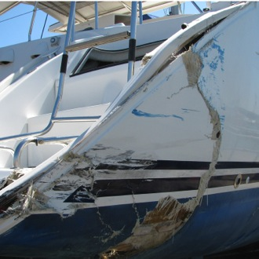
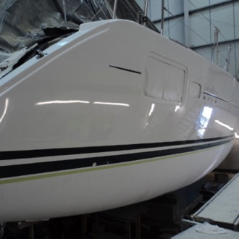
LAGOON 410
Major repairs following serious collision damage whilst alongside
Including rigging, de-rigging and re-rigging
Stripping of starboard hull and rebuilding hull shell and structural elements
Re-instating new and modifying existing joinery
Re-fitting engine, plumbing and engineering systems
foxsmarina.com

Slide 23
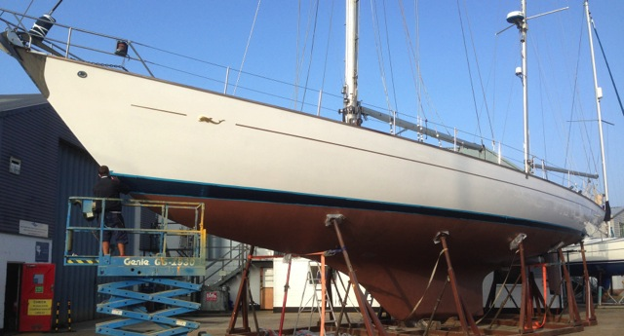
OCEAN 72
Major refit that included rebuilding the bottom shell with glass & epoxy
Cutting out, drying and re-laminating topsides chain plate box’s in epoxy and glass
Complete re-fair of hull and topsides
Complete re-spray of hull and deck using Awlgrip products
Bottom finished in Coppercoat – 10+year antifouling
foxsmarina.com

Slide 24
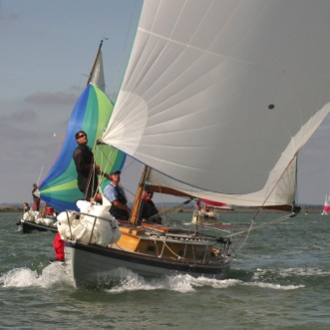
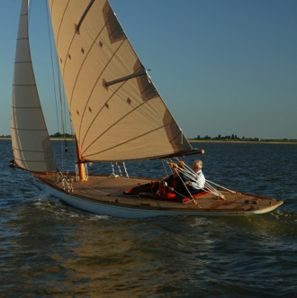
1963 STELLA & 1899 FIFE GAFF SLOOP
Ongoing annual maintenance of these beautiful, traditional classics, including new planking and refastening, repainting and varnishing.
foxsmarina.com

Slide 25

KISMET – 1889 Fife Gaff Cutter
Following complete rebuild, Fox’s carried out all paint and varnish finishes and a complete re-rig in traditional materials including new timber spars.
foxsmarina.com

Slide 26
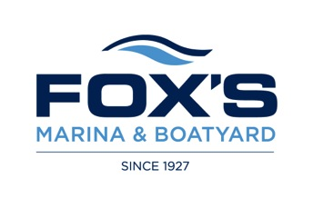
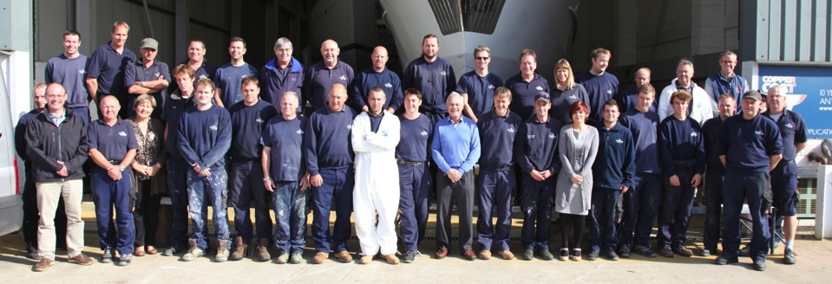
Our experienced and friendly team at your service.
Fox’s Marina & Boatyard, Ipswich, Suffolk, IP2 8SA +44 (0) 1473 689 111 foxs@foxsmarina.com
foxsmarina.com

